Slide 1
Introduction to Computer Graphics
Lecture 9:
Shading 3 (Texture Mapping cont.)
http://www.cs.ucsb.edu/~lingqi/teaching/games101.html

Slide 2
Last Lectures
Shading 1 & 2
-
-
-
-
Blinn-Phong reflectance model Shading models / frequencies Graphics Pipeline
Texture mapping
2

Slide 3
Today
Shading 3
-
-
-
Barycentric coordinates Texture queries Applications of textures
3

Slide 4
Interpolation Across Triangles: Barycentric Coordinates

Slide 5
Interpolation Across Triangles
Why do we want to interpolate?
Specify values at vertices
Obtain smoothly varying values across triangles
What do we want to interpolate?
Texture coordinates, colors, normal vectors, …
How do we interpolate?
Barycentric coordinates

Slide 6

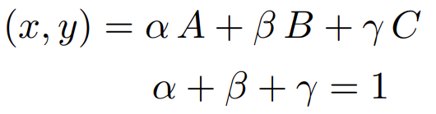
Barycentric Coordinates
A coordinate system for triangles
(x, y)
Inside the triangle if all three coordinates are non-negative
B
A

Slide 7
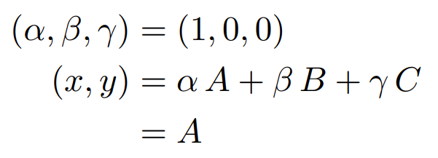
Barycentric Coordinates
What’s the barycentric coordinate of A?
C
B
A
(x, y)

Slide 8
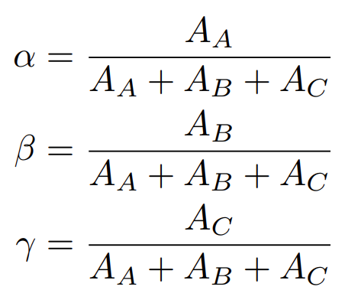
Barycentric Coordinates
Geometric viewpoint — proportional areas
C
A A
B
A
A
C
B
A

Slide 9
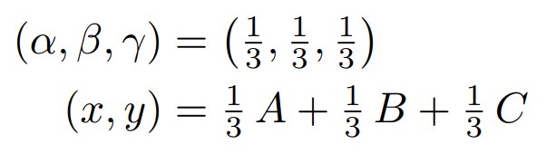
Barycentric Coordinates
What’s the barycentric coordinate of the centroid?
C
(x, y)
B
A

Slide 10
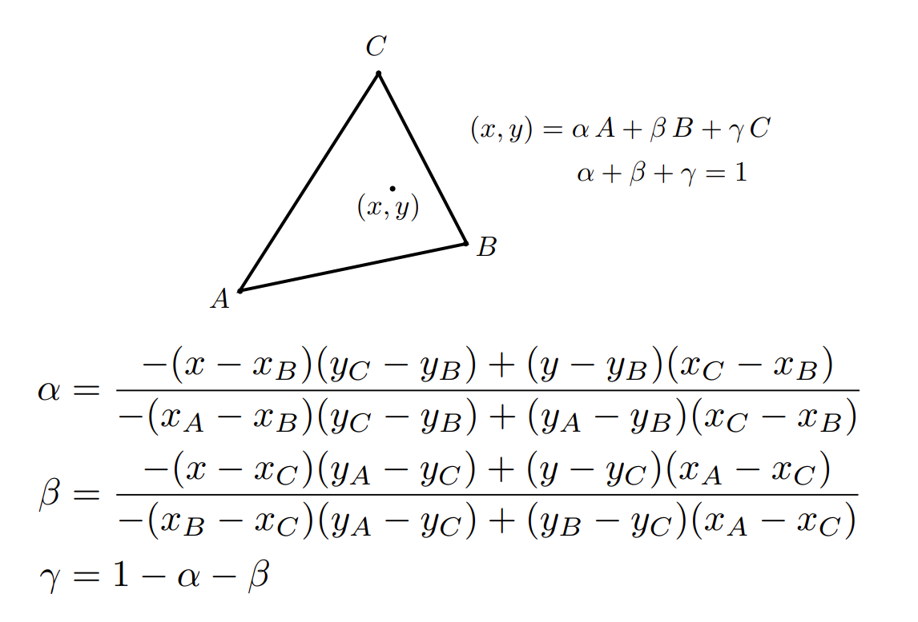
Barycentric Coordinates: Formulas

Slide 11
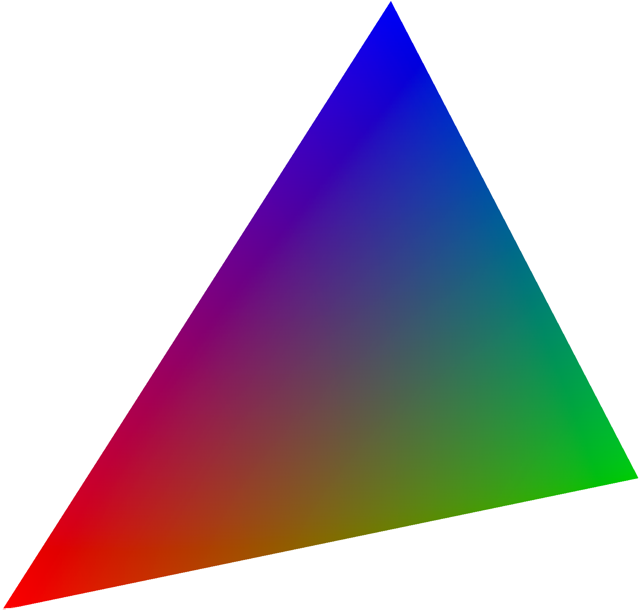

Using Barycentric Coordinates
Linearly interpolate values at vertices
V_{C}
V
VA, VB, VC can be positions, texture coordinates, color, normal, depth, material attributes…
V_{B}
V_{A}
However, barycentric coordinates are not invariant under projection!

Slide 12
Applying Textures

Slide 13
Simple Texture Mapping: Diffuse Color
Usually a pixel’s center
for each rasterized screen sample (x,y): (u,v) = evaluate texture coordinate at (x,y) texcolor = texture.sample(u,v);
set sample’s color to texcolor;
Using barycentric coordinates!
Usually the diffuse albedo Kd (recall the Blinn-Phong reflectance model)
14

Slide 14
Texture Magnification
(What if the texture is too small?)

Slide 15



Texture Magnification - Easy Case
Generally don’t want this — insufficient texture resolution A pixel on a texture — a texel (纹理元素、纹素)
Nearest
Bilinear
Bicubic

Slide 16

Bilinear Interpolation
Want to sample texture value f(x,y) at red point
Black points indicate texture sample locations

Slide 17

Bilinear Interpolation
u01
u11
Take 4 nearest sample locations, with texture values as labeled.
u00
u10

Slide 18
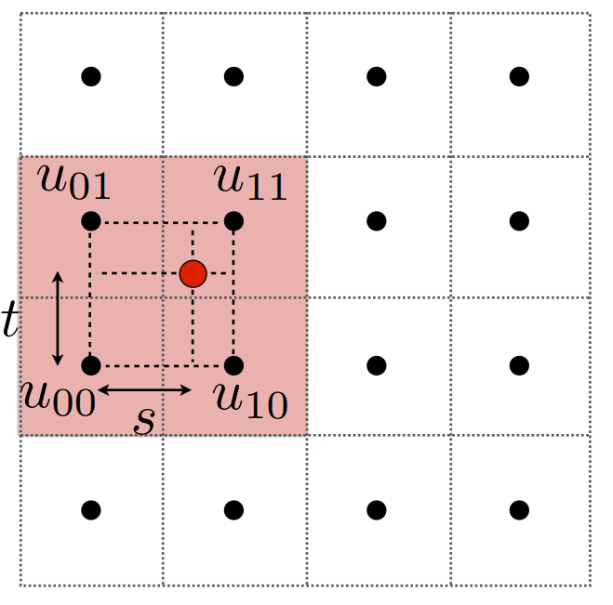
Bilinear Interpolation
And fractional offsets, (s,t) as shown

Slide 19
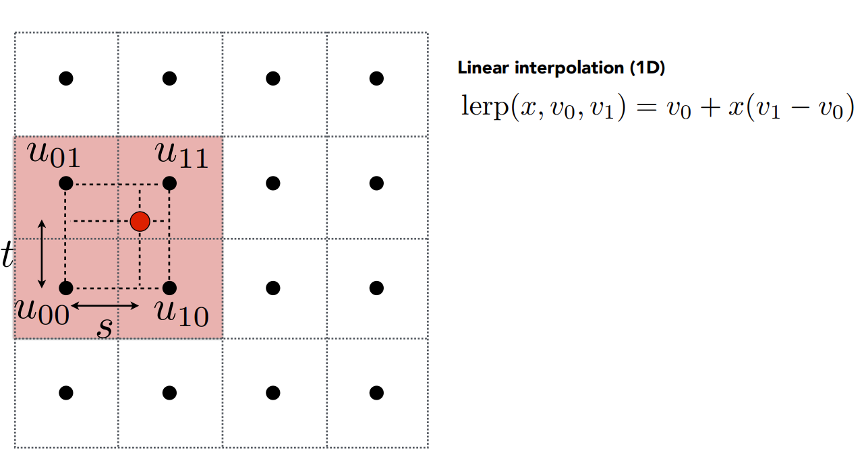
Bilinear Interpolation

Slide 20
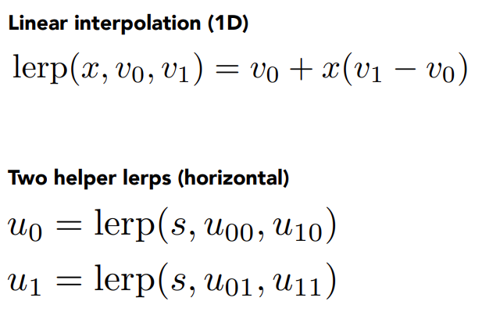


Bilinear Interpolation
u₁
u01 u11
t
u00 u10
u₀

Slide 21
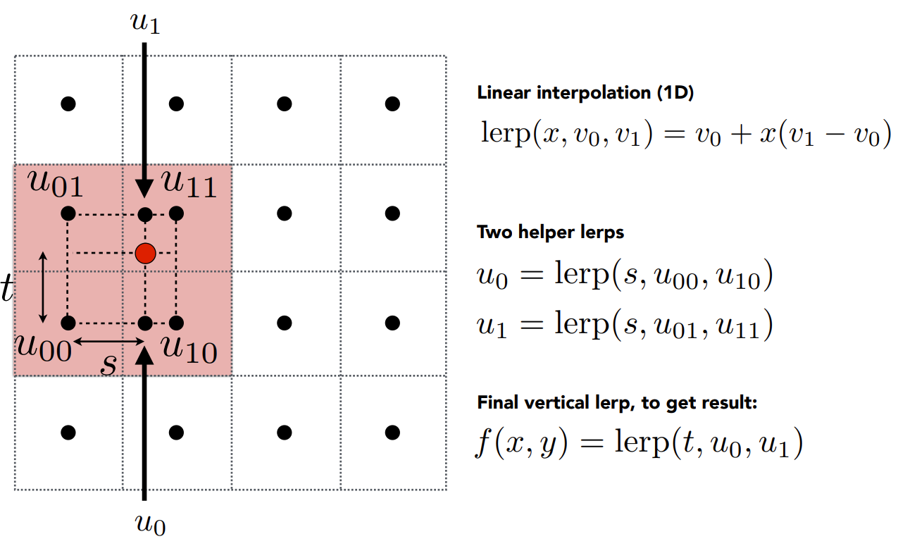
Bilinear Interpolation

Slide 22
Texture Magnification - Easy Case
Bilinear interpolation usually gives pretty good results at reasonable costs
Nearest
Bilinear
Bicubic

Slide 23
Texture Magnification (hard case)
(What if the texture is too large?)

Slide 24
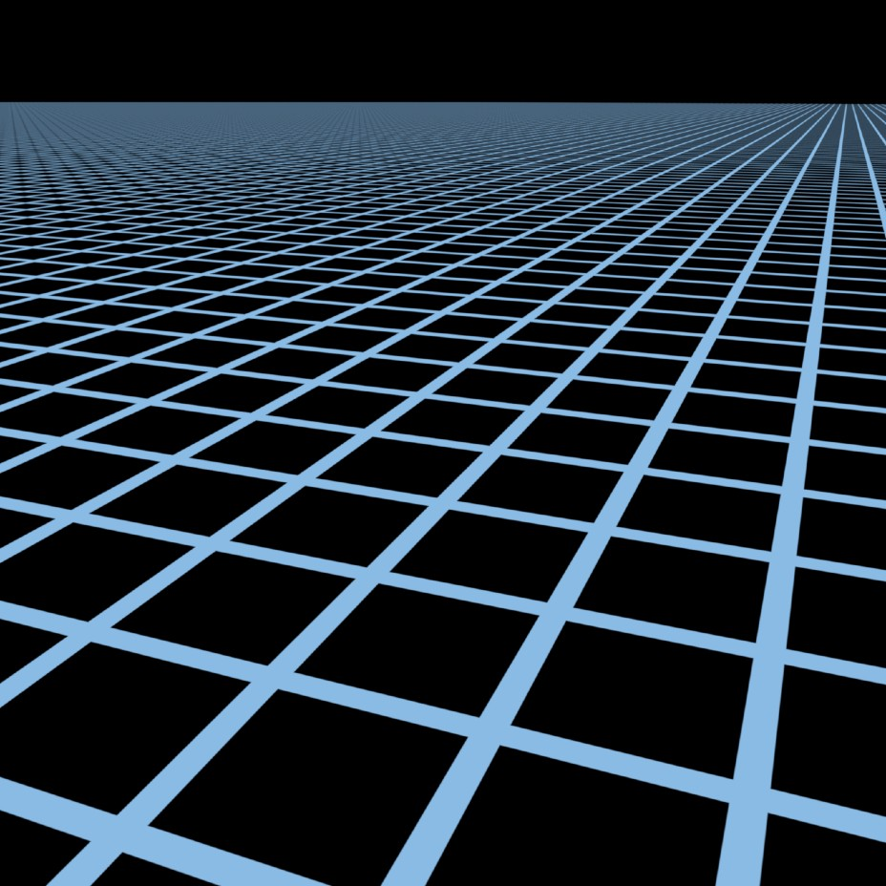

Point Sampling Textures — Problem
Moire
Jaggies
Reference
Point sampled

Slide 25
Screen Pixel “Footprint” in Texture
Upsampling (Magnification)
Downsampling (Minification)

Slide 26
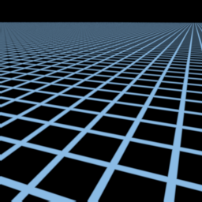
Will Supersampling Do Antialiasing?
Yes! But costly!
512x supersampling

Slide 27
Antialiasing — Supersampling？
Will supersampling work?
Yes, high quality, but costly
When highly minified, many texels in pixel footprint
Signal frequency too large in a pixel
Need even higher sampling frequency
Let’s understand this problem in another way
What if we don’t sample?
Just need to get the average value within a range!

Slide 28
Point Query vs. (Avg.) Range Query

Slide 29

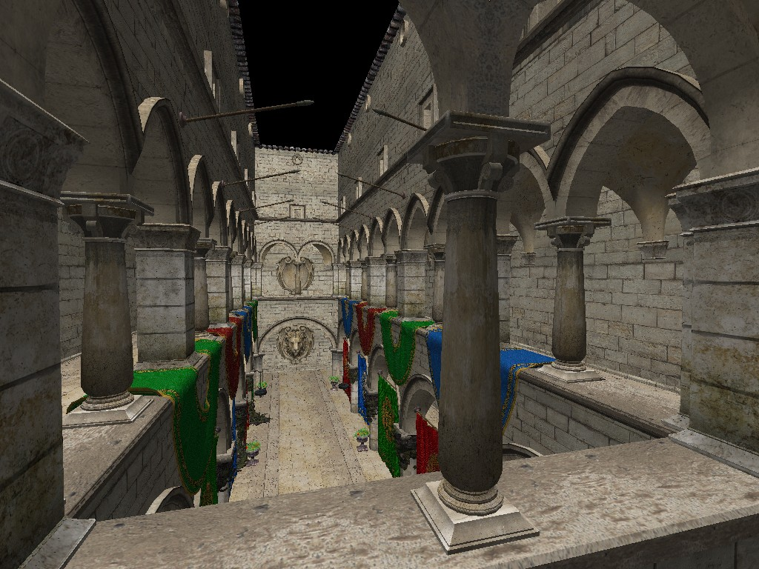
Different Pixels -> Different-Sized Footprints

Slide 30
Mipmap
Allowing (fast, approx., square) range queries

Slide 31








Mipmap (L. Williams 83)
“Mip” comes from the Latin “multum in parvo", meaning a multitude in a small space
Level 0 = 128x128
Level 1 = 64x64
Level 2 = 32x32
Level 3 = 16x16
Level 4 = 8x8
Level 5 = 4x4
Level 6 = 2x2
Level 7 = 1x1

Slide 32
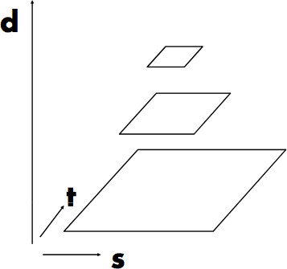
Mipmap (L. Williams 83)
D
D = 2
D = 1
v
D = 0
u
“Mip hierarchy” level = D
What is the storage overhead of a mipmap?

Slide 33
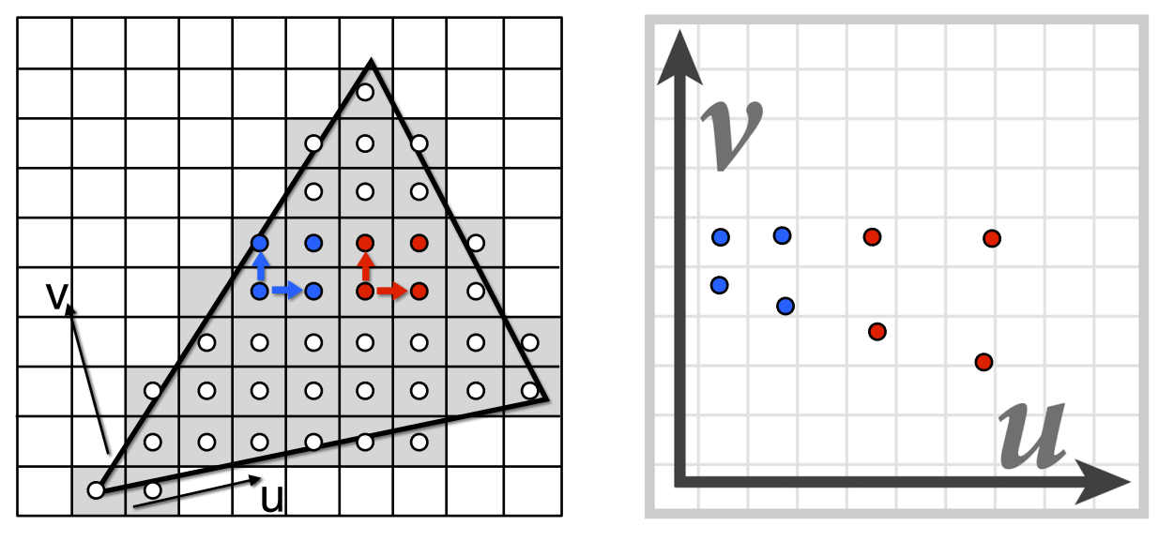
Computing Mipmap Level D
Screen space (x,y) Texture space (u,v)
Estimate texture footprint using texture coordinates of neighboring screen samples

Slide 34
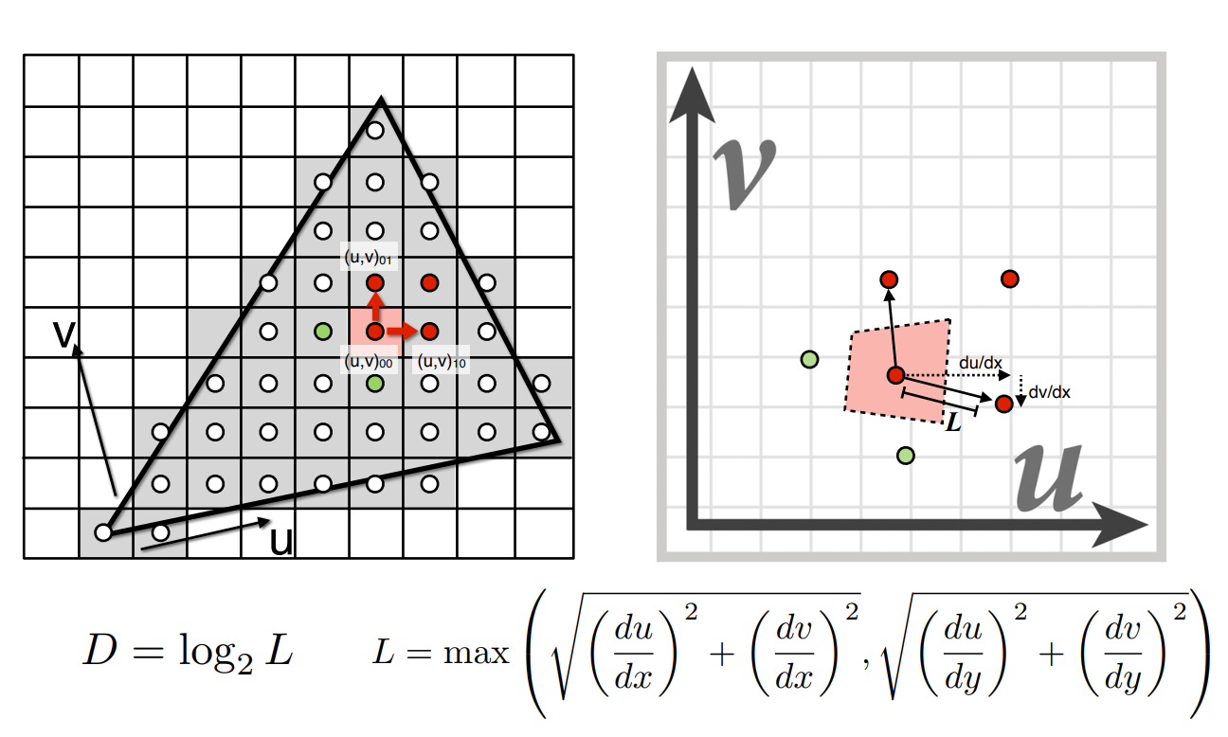
Computing Mipmap Level D

Slide 35
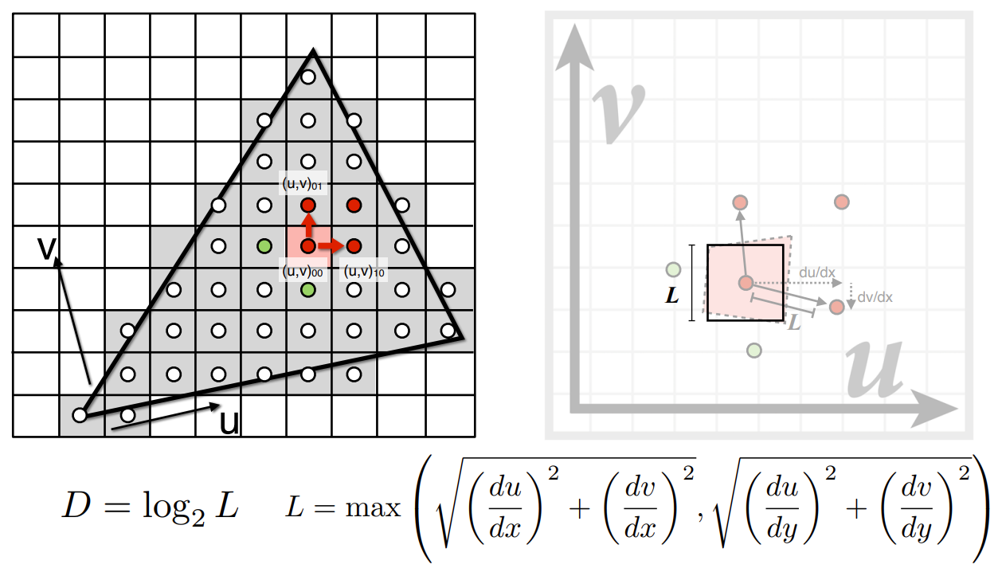
Computing Mipmap Level D

Slide 36

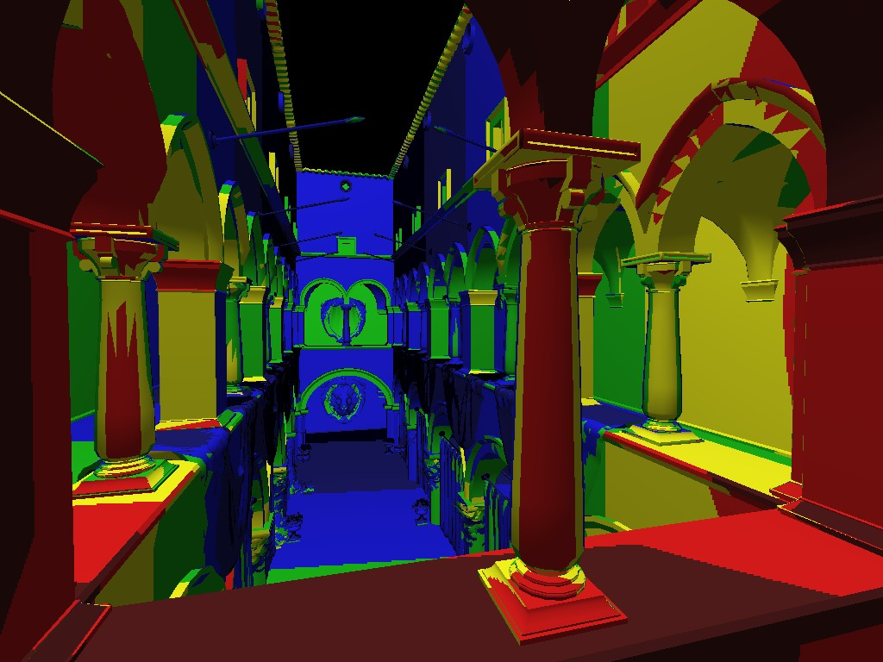
Visualization of Mipmap Level
D rounded to nearest integer level

Slide 37



Trilinear Interpolation
Mipmap Level D
Bilinear result
Mipmap Level D+1
Bilinear result
Linear interpolation based on continuous D value

Slide 38

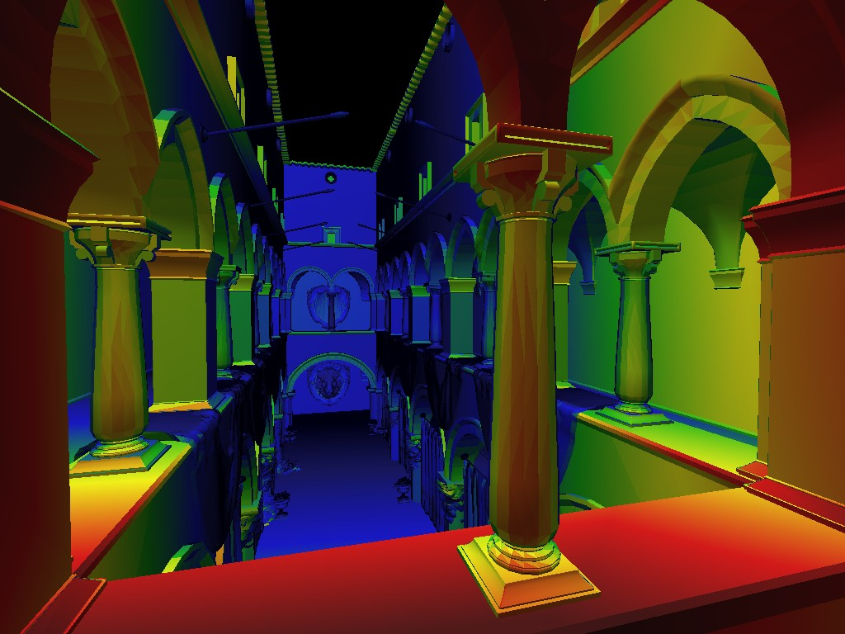
Visualization of Mipmap Level
Trilinear filtering: visualization of continuous D

Slide 39
Mipmap Limitations
Point sampling

Slide 40
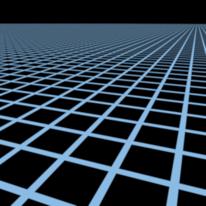
Mipmap Limitations
Supersampling 512x (assume this is correct)

Slide 41
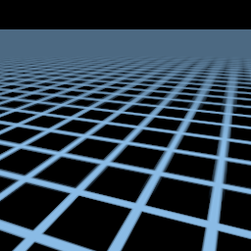
Mipmap Limitations
Overblur Why?
Mipmap trilinear sampling

Slide 42
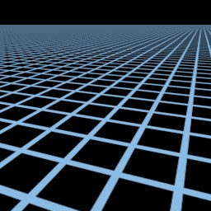
Anisotropic Filtering
Better than Mipmap!

Slide 43
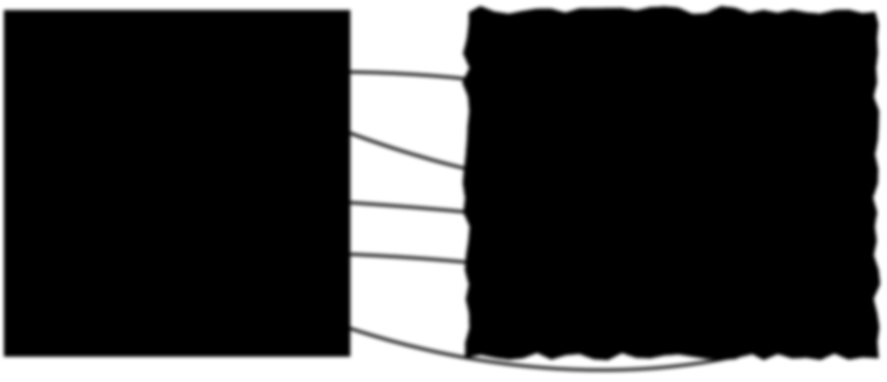
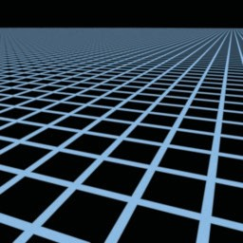




Irregular Pixel Footprint in Texture
Screen space
Texture space

Slide 44
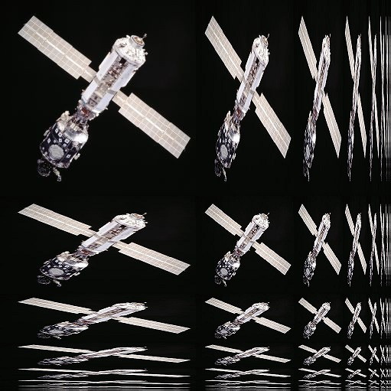
Anisotropic Filtering
Ripmaps and summed area tables
Can look up axis-aligned rectangular zones
Diagonal footprints still a problem
Wikipedia

Slide 45
Thank you!
(And thank Prof. Ravi Ramamoorthi, Prof Lingqi Yan and Prof. Ren Ng for many of the slides!)

